Slide 1
Rev. Kevin Klug
Ministry of Christian Giving District Chairman

Slide 2
WELS Ministry of Christian Giving mission
We encourage members to excel in the grace of giving and assist them in making planned gifts to support the gospel ministry of their congregations, synod, and WELS-affiliated ministries.
Notes:
MCG assists the COP with their responsibility to fund the Lord’s work through our synod. This funding is provided through Congregation Mission Offerings as well as direct gifts to WELS from individuals, groups, and foundations. Those offerings are prompted by Christ’s saving love for us and his Spirit’s gift of generosity.

Slide 3
Devotional thought
“Command those who are rich in this present world not to be arrogant nor to put their hope in wealth, which is so uncertain, but to put their hope in God, who richly provides us with everything for our enjoyment. Command them to do good, to be rich in good deeds, and to be generous and willing to share. In this way they will lay up treasure for themselves as a firm foundation for the coming age, so that they may take hold of the life that is truly life” (1 Timothy 6:17-19).
Notes:
As we offer gifts of thanks and praise to our Savior, let us remember that Jesus has made us rich in every way! He warns us against arrogance that loves wealth instead of the Giver of all we have. He also encourages us to be generous and willing to share as we embrace the cross and anticipate the crown.

Slide 4
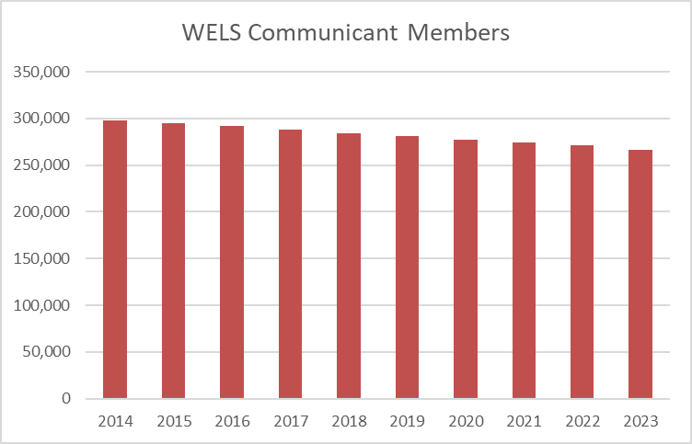
Blessings and opportunities
Notes:
First let’s look at some data to remind us of our church body’s blessings and opportunities.
We’re all aware of the decline in the membership of WELS that has been taking place since the peak in membership in 1990.

Slide 5
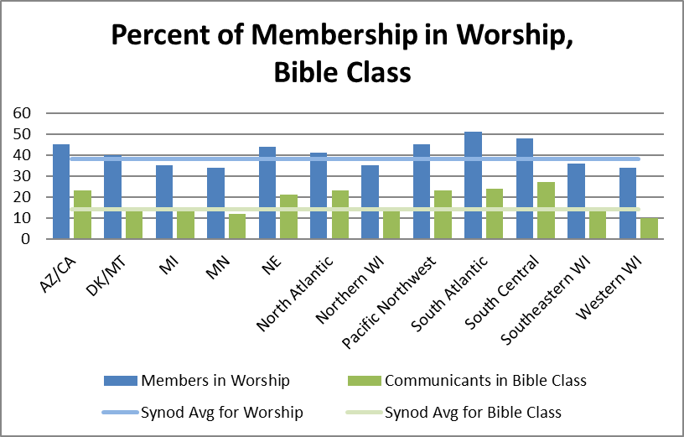
Blessings and opportunities
2023 statistics:
38% in worship
14% in Bible class
Notes:
Another challenge (in addition to declining membership) is that average participation in worship and Bible class is low – although both average worship and Bible class attendance increased from the previous year (35% in worship and 13% Bible class in 2022). Let’s thank our gracious Savior for those who are regularly growing in his grace and ask him to help us encourage others to do the same.

Slide 6
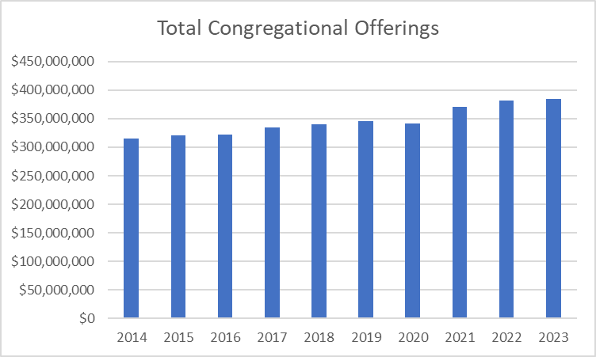
Blessings and opportunities
2023 total congregational offerings: $385 million
Notes:
A blessing is that total congregational offerings have trended up each year – except during 2020 – despite declining membership and low worship and Bible class attendance.

Slide 7
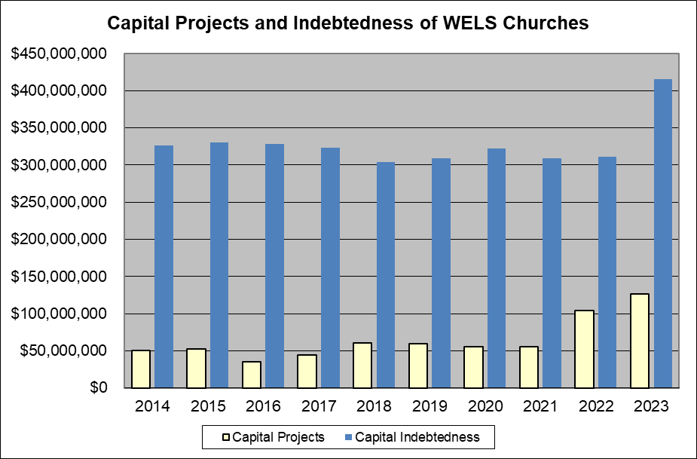
Blessings and opportunities
Notes:
Congregational capital projects and the resulting indebtedness were on hold during the pandemic years. With life returned to normal, we are seeing a large increase in both categories. Lord-willing, these projects and indebtedness won’t impact the funding of other ministries.

Slide 8
Blessings and opportunities
Congregation Mission Offerings for 2023 were $23.39 million
0.3 percent ($64,000) more than 2022 CMO
1.9 percent higher ($436,000) than projected receipts.
This is the fourth consecutive year in which our congregations have offered a record total of CMO.
This is the second year in which CMO has surpassed $23 million.
Let us thank the Lord for continuing to bless us through his people’s generous gifts!
Notes:
Congregation Mission Offerings have been strong—especially in the last several years. We’re truly grateful to our heavenly Father for the wonderful thank offerings his congregations give him for the work of our church body. We’re also thankful for WELS members’ generous participation in the gospel ministry we conduct together.

Slide 9
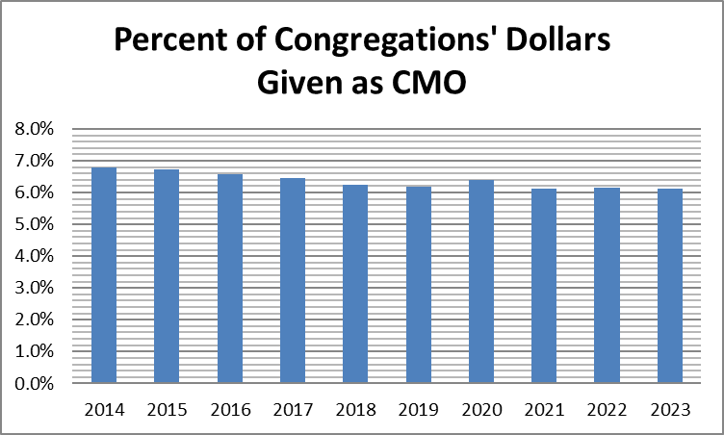
Blessings and opportunities
2.1% of personal income to offerings
6.1% of church offerings given as CMO
Notes:
Comparing offerings per communicant with our government’s latest figure for per capita income, the average percentage of income given is 2.1% (ahead of American Christians who gave 1.8%). The percentage of offerings that WELS congregations pass along for synod ministry compared to all offerings reported by our churches had been trending downward but has leveled off in recent years.
2.1% income figure—based on WELS 2023 Statistical Report and the U.S. Dept. of Commerce Bureau of Economic Analysis (divided 2023 synod per communicant giving figure of $1,456 by 2023 U.S. per capita income of $68,531).
1.8% giving by American Christians from Empty Tomb for 2020 (latest year measured).
6.1% CMO figure—based on data from WELS 2023 Statistical Report.

Slide 10
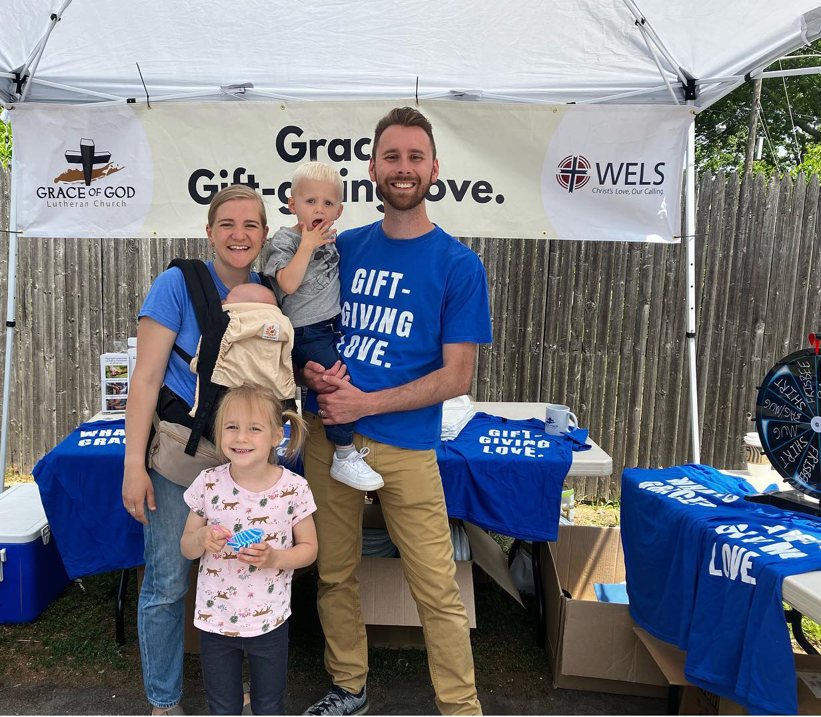
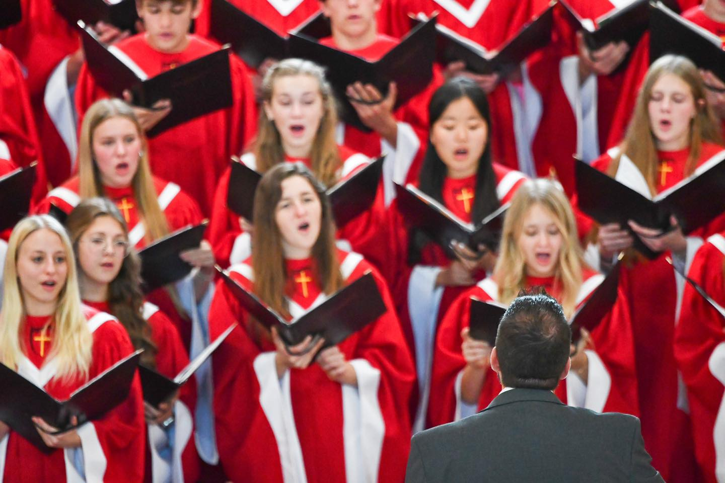
Blessings and opportunities
WELS Endowment Funds
By the grace of Jesus, we have received $40.7 million in gifts since 2005 (with another $84.1 million expected through donors’ wills) and distributed $1.3 million in July from the WELS Missions and Ministerial Education Endowment Funds!
Notes:
These funds were established by the 2005 WELS Convention and continue to be a blessing to our work for Christ!
Pictured:
Left: Timothy Walsh, a home missionary at Grace of God Lutheran, Dix Hills, N.Y., with his family.
Right: Michigan Lutheran Seminary’s choir.

Slide 11
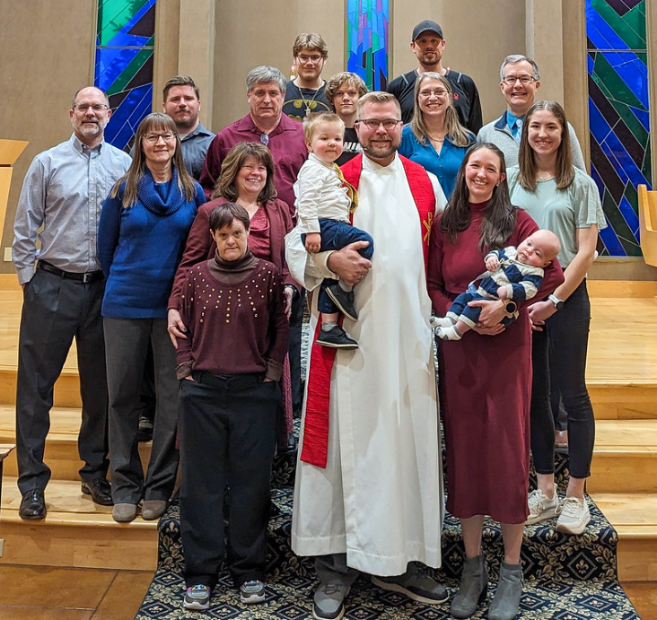
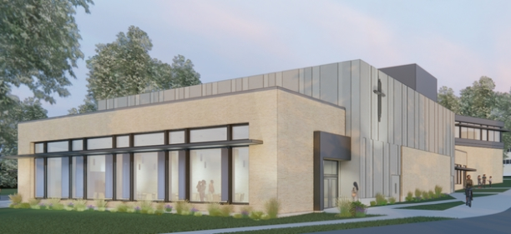
Blessings and opportunities
Special offerings
100 Missions in 10 Years
Luther Preparatory School Music Center
Notes:
Ministry of Christian Giving is working with WELS Home Missions on the 100 Missions in 10 Years synodwide campaign that was approved at the 2021 WELS convention. The goal of the initiative is to plant 100 new home mission churches and enhance 75 existing ministries from 2023-2033. Since July 2021, 1,899 individuals and groups have offered 3,040 gifts/commitments totaling $3.14 million. We thank God and his people for such generosity! This synodwide campaign runs through June.
MCG is partnering with Luther Preparatory School, WELS Chief Financial Officer Kyle Egan, and consulting firm Generis on launching a capital campaign to build a new music center on the Watertown, Wis., campus.
We are also coordinating with Wisconsin Lutheran Seminary, Kyle Egan, and Generis to conduct a capital campaign feasibility study for the school’s education wing, remodeled offices, and auditorium gathering space.

Slide 12
Blessings and opportunities
CMO subscriptions for 2024 point to a 1.0 percent decrease from 2023 actual offerings.
Through April, offerings total $7.45 million, which is up $517,000 (7.5 percent) from the CMO that we received during the first four months of 2023 and $266,000 (3.7 percent) higher than projected receipts.
We praise the Lord and thank his people for these gifts and commitments!
Notes:
I mentioned how the last several years of CMO were especially strong – and 2024 offerings continue to exceed expectations!

Slide 13
Blessings and opportunities
When setting CMO, aim for ten percent of offerings. If at or above this goal, encourage your congregation to maintain its generous support or consider increasing it as you’re able with God’s blessing.
“For if the willingness is there, the gift is acceptable according to what one has, not according to what one does not have” (2 Corinthians 8:12).
“Excel in this grace of giving. . . . For you know the grace of our Lord Jesus Christ” (2 Corinthians 8:7,9).
Notes:
When setting CMO, we encourage all our congregations to joyfully consider designating ten+ percent of general offerings for CMO. The reason? Because you know the grace of our Lord Jesus Christ! Also, it’s the foundational source of synod support for the areas of ministry that we’ve been hearing about this week.

Slide 14
Congregation Mission Offerings
WELS Connection
Together e-newsletter
Forward in Christ
Annual Report (includes PowerPoint)
Annual CMO setting materials
Notes:
Please note these resources that are designed to keep you and others informed about how CMO and unrestricted IMO are being used to proclaim the firm foundation of God’s Word around the world.

Slide 15
Individual offerings
WELS Christian giving counselors
Offer Christ-centered, relationship-based, free, confidential help
Connect donors’ interests with our areas of ministry
Assist with major gifts of assets according to donors’ interests and abilities
Nurture donors to consider supporting Christ’s work now and through their wills as the Lord has blessed them

Slide 16
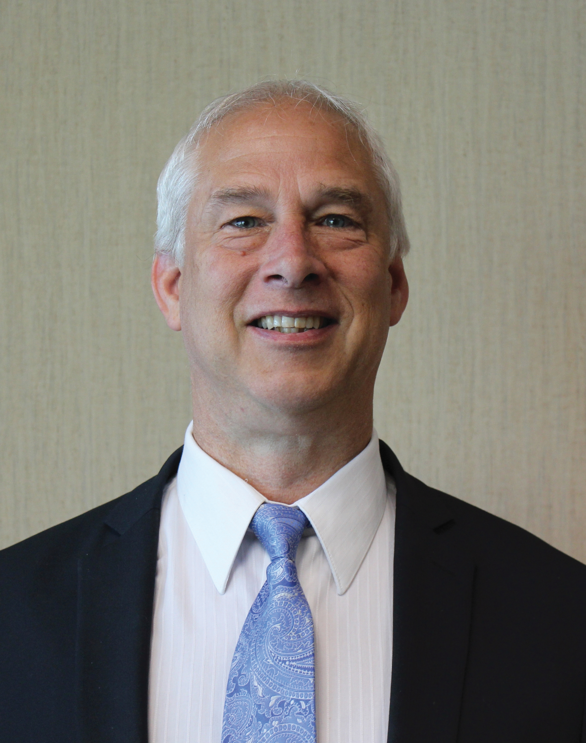
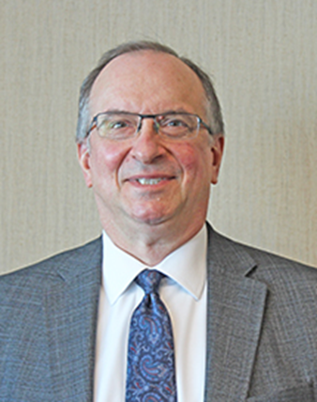
Individual offerings
Your giving counselors:
Rev. Steve Schmeling, Current Gifts
Phone: 612-222-2050
E-mail: steve.schmeling@wels.net
Rev. Kurt Lueneburg, Deferred Gifts
Phone: 612-599-9316
E-mail: kurt.lueneburg@wels.net
Notes:
WELS Christian giving counselors provide free assistance with gifts to your congregation, WELS, or a WELS-affiliated ministry.
8 pastors, 1 teacher, 4 laymen

Slide 17
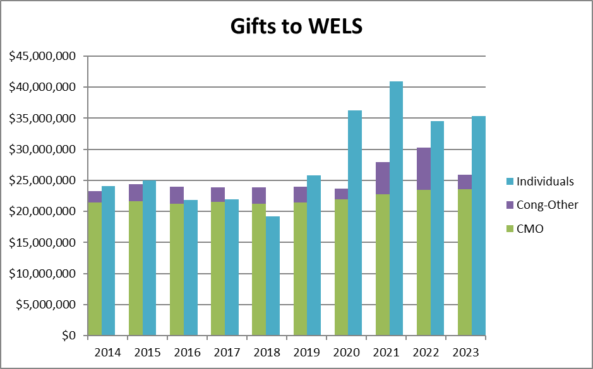
Individual offerings
Notes:
This chart shows individual offerings compared to congregational offerings per the 2022 WELS Statistical Report. Individual offerings include gifts from individuals, foundations, closed congregations, etc. What amazing evidence of joyful generosity, particularly in the past few years.

Slide 18
Individual offerings
In fiscal year 2023-24, WELS Christian giving counselors (12.1 full-time equivalents)
conducted 1,300 meaningful visits and 2,697 meaningful contacts with donors.
nurtured $11.3 million in immediate gifts and $31.9 million in deferred expectancies from assigned donors.
helped donors arrange 184 major gift opportunities (current and deferred) totaling $42.7 million.
To God be the glory!
Notes:
Jesus is blessing our service to his people and him!

Slide 19
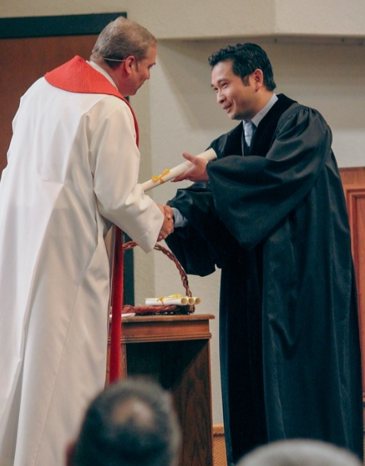
Individual offerings
IRA charitable distributions
Those 70.5 or older can make tax-free gifts to ministry from their IRAs.
Consider directing required minimum distributions to ministry to save on taxes, then using the cash you would have given to charity for other needs.
wels.net/qcd
Notes:
The following slides include ways that members can support their congregations and synod.
Qualified charitable distributions from individual retirement accounts have been a popular way to give in recent years. If you do not need the required minimum distributions that you are required to take from your IRA (now starting at age 73), consider directing those to ministry to save on taxes, then use the cash you would have given to charity for other needs (there’s a $105,000 limit per IRA holder each year). There is a new opportunity this year to direct your QCD into a CGA (up to $53,000).
A unique IRA QCD gift acknowledgment letter is available from WELS Foundation at wels.net/qcd.

Slide 20
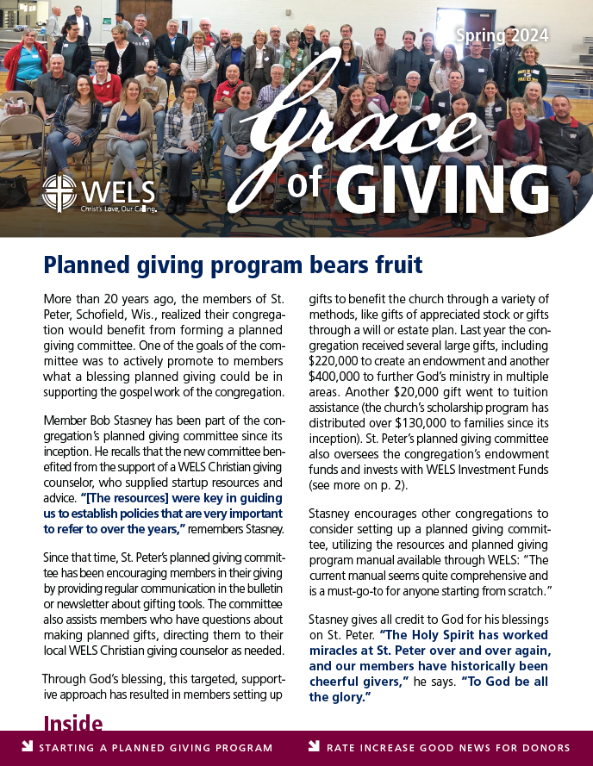
Resources
Grace of Giving
Newsletter from WELS Ministry of Christian Giving and WELS Foundation with ministry updates and planned giving options
wels.net/graceofgiving
Notes:
We send the Grace of Giving newsletter to inform people about different ways that WELS members may use to offer special gifts to the ministries that they love.

Slide 21
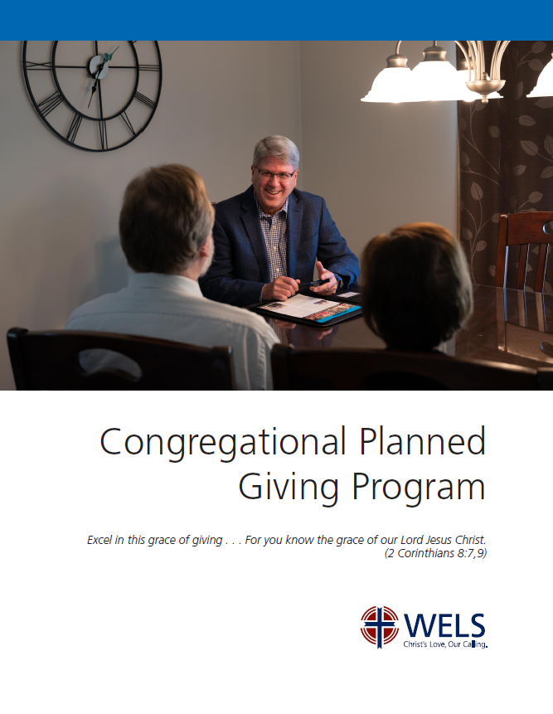
Resources
Congregational Planned Giving
Encourage planned giving in your church using synod resources and your local giving counselor
wels.net/plannedgivingprogram
Notes:
Many churches may have experienced a challenging financial outlook that is eased by an unexpected bequest from a member who went to be with Jesus. Churches can work now to inform members of these giving opportunities so that planned gifts continue to arrive for years to come. WELS Ministry of Christian Giving provides this planned giving program manual with “quick starts” to promoting planned giving and setting up an endowment as well as more complex options.

Slide 22
Resources
Stewardship Toolbox
“Mission prayers” for various ministries
“Stewardship by the Lectionary” devotionals based on weekly readings share God’s stewardship truths according to the pericope
mcg.welsrc.net
Notes:
Every other month church leaders can find two months’ worth of Stewardship Toolbox resources at MCG’s resource collection online, mcg.welsrc.net.
“Mission prayers” allow the congregation or individuals to learn about and pray for different areas of our synod ministry.
“Stewardship by the Lectionary” includes short stewardship devotions based on weekly readings from the lectionary – a good way to encourage members each week with how they can fully put their trust in our gracious God.

Slide 23
Scriptural encouragement
“Therefore, brothers and sisters, since we have confidence to enter the Most Holy Place by the blood of Jesus…Let us hold unswervingly to the hope we profess, for he who promised is faithful. And let us consider how we may spur one another on toward love and good deeds, not giving up meeting together, as some are in the habit of doing, but encouraging one another—and all the more as you see the Day approaching” (Hebrews 10:19, 23-25).
Notes:
As we stand in Jesus and the sure hope he gives us, we may eagerly perform the love and good deeds he prepared in advance for us to do and encourage one another in every situation since we know the Day of his glorious return is approaching. God bless our ongoing work in Christ!

Slide 24
Thank you!
WELS Ministry of Christian Giving
mcg@wels.net
800-827-5482
Notes:
Thank you for your time today and your partnership in Christ’s kingdom. The grace of the Lord Jesus be with you!

