Slide 1
Notes:
WELS Home Missions plants new churches and assists mission-minded congregations in the United States, Canada, and English-speaking West Indies. Home Missions currently supports 157 congregations with financial subsidy or district mission board/mission counselor assistance, with 32 of those being cross-cultural mission congregations. Home Missions also provides over 45 campus ministries with financial support, while assisting hundreds of other congregations that serve college students around the United States and Canada.
At the 2021 Synod Convention, delegates enthusiastically approved a WELS Home Missions initiative to plant 100 home mission churches and enhance 75 ministries in 10 years beginning in 2023. During the same time, we want to support 75 enhancement grants to help existing congregations reach more souls, often in other cultures.

Slide 2
Notes:
Video link: https://vimeo.com/951681111

Slide 3
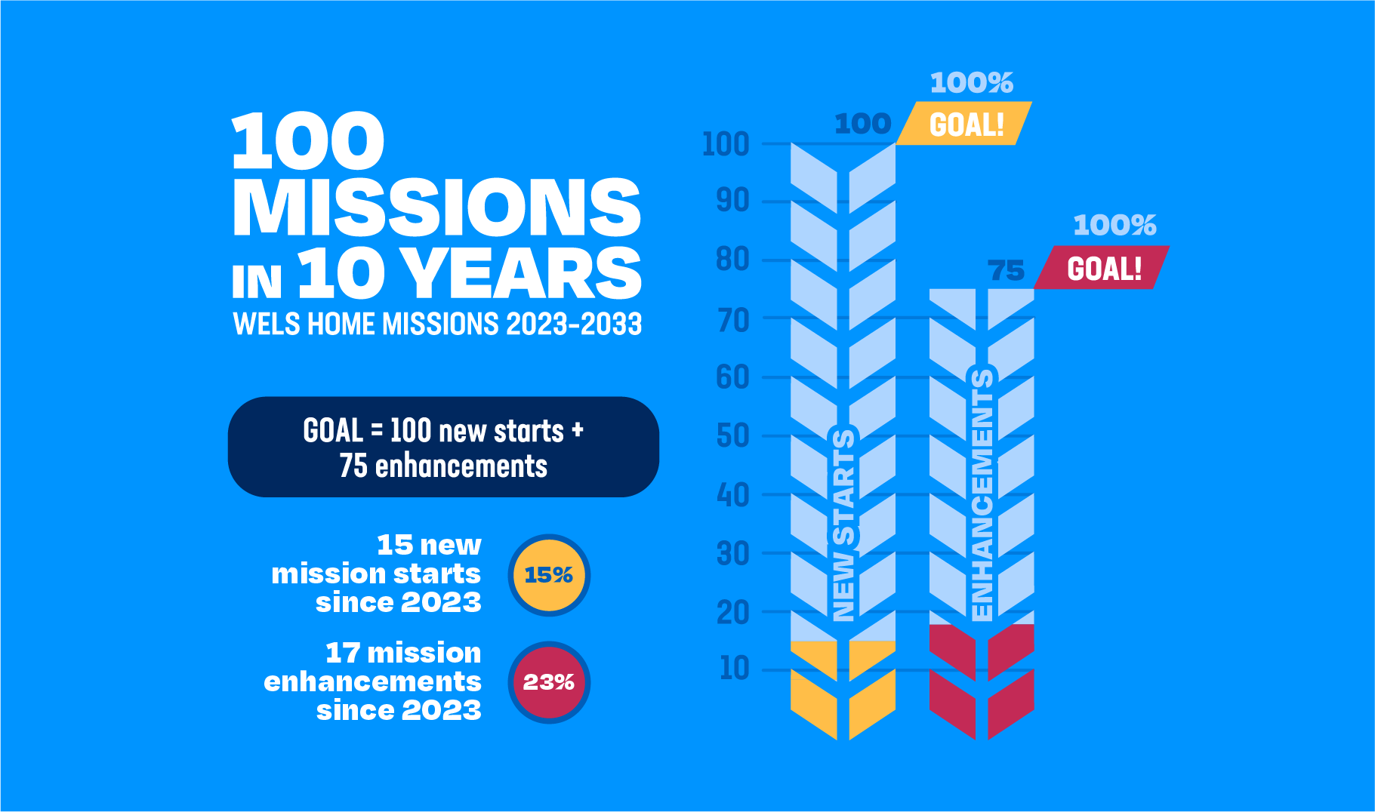
Notes:
WELS Home Missions approved 12 new home mission starts and enhancements in April 2024. That puts us at a total of 15 new starts and 17 enhancements as we work towards our synod’s goal of starting 100 missions and enhancing 75 ministries by 2033.

Slide 4
2023/2024 New Starts:
15 total
Bend, Ore.
Cedar Lake, Ind.
Conway, Ark.
Easley, S.C.
Williston, N.D.
Buffalo, Wyo.
Bentonville, Ark.
Boston, Mass.
Cincinnati, Ohio
Idaho Falls, Idaho
Kalispell, Mont.
Kronenwetter, Wis.
Marquette, Mich.
North Collin County, Tex.
Panama City Beach, Fla.
Notes:
Read more about all of these new mission starts on the individual cards found at wels100in10.net.

Slide 5
2023/2024 Enhancements:
17 total
Calvary, Dallas, Tex.
Crossroads, Chicago, Ill. (Restart)
Faith, Prior Lake, Minn.
Good Shepherd, Plymouth, Wis.
Northdale, Tampa, Fla.
St. Marcus, Milwaukee, Wis.
St. Paul, Calgary, AB, Canada
Mt. Calvary, Anderson, Calif.
Christ the King, Palm Coast, Fla.
Hope in Deerfield, Wis.
Cross of Christ, Las Cruces, N.M.
Beautiful Savior, Des Moines, Iowa
Fairview, Milwaukee, Wis.
Christ the King, Port Charlotte, Fla.
Divine Savior, Sienna, Tex.
Good Shepherd, Midland, Tex.
Our Redeemer, Ladysmith, Wis.
Notes:
Read more about all of these new mission enhancements on the individual cards found at wels100in10.net.

Slide 6
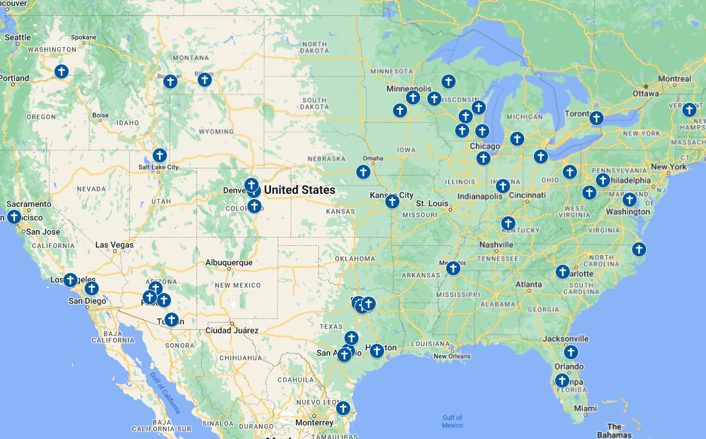
There’s still more work to be done!
Notes:
There are 58 new mission starts that the district mission boards have identified for the next 1-2 years. There are more places we are ready to go!
The financial landscape has changed a bit since starting this initiative was approved and the Home Missions task force did it work in 2021. As the Board for Home Missions considered new ministry requests this year, they worked hard to find balance between trusting God to do immeasurably more than we can imagine and not putting God to the test as they aim to wisely manage the dollars God’s people have given to WELS and Home Missions. Three main factors are contributing to the rising costs:
10% rise in health insurance costs
Increased land and construction/renovation costs
Increased interest rates that impact Church Extension Fund interest rates.
The following new mission starts were approved at the recent meetings, but WELS Home Missions didn’t have the money needed to fund them at the time:
Barre, VT: The North Atlantic district mission board is working with committed members at Christ the Redeemer in Barre, VT, to restart their congregation with a full-time missionary.
Cypress, TX: The district mission board is working with a committed core group in Cypress, one of the fastest growing communities in the U.S. The group meets monthly for Bible study.
New River, AZ: An engaged core group is meeting with their mission counselor to discuss outreach while potentially being served by the pastor at Deer Valley in Phoenix, AZ.
San Tan Valley, AZ: Mission Counselor Uhlhorn is meeting with area pastors to discuss how mission work can get started in this extremely fast growing area southeast of Phoenix.
Erie, CO: There are as many as 20 WELS families living in the Erie area, making it a great location to plant a church.
Arlington, TN: Gloria Dei in Memphis, TN, is evaluating whether to restart their ministry or start a new mission in a growing area northeast of Memphis.
Silverleaf, FL: A core group from Victory in Jacksonville, FL, is looking to plant a new mission in Silverleaf/St. Augustine.
Jarrell, TX: The district mission board is collaborating with Rev. Don Patterson at Holy Word in Austin, TX, and a small core group to start a mission in this area. Projected population growth for the target area is 40% (7,500) over the next 10 years.
Kyle/Buda, TX: The district mission board is collaborating with Pastor Curt Backhaus at Risen Savior in Austin, TX, to start a mission in this area. Projected population growth for the target area is 37% (44,000) over the next 10 years.

Slide 7
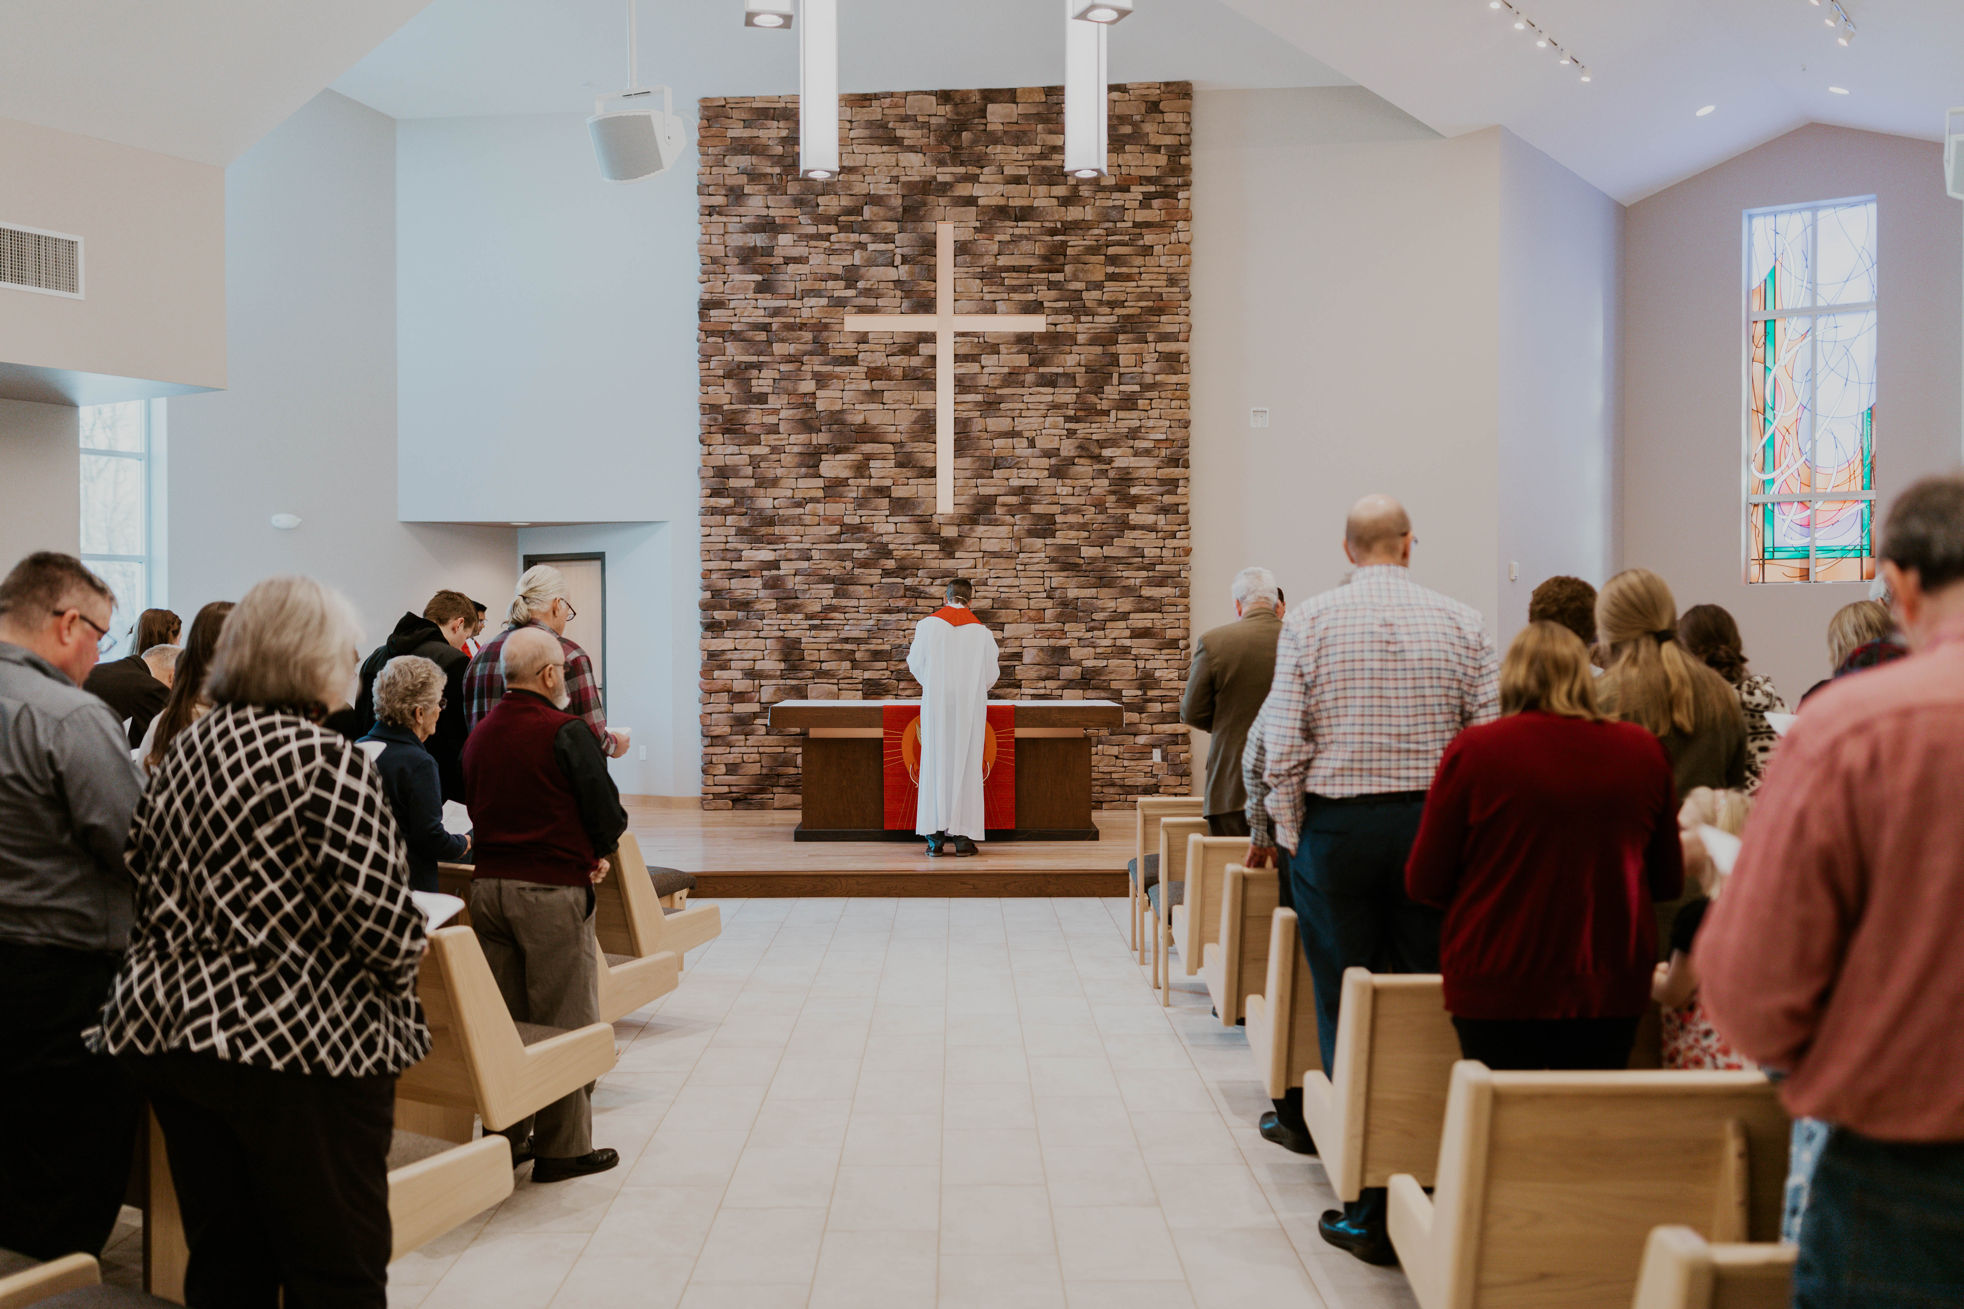
Financial blessings for Home Missions
$6.3 million from Congregational Mission Offerings
$7 million+ in special gifts from individuals, organizations, and estates
$2 million in gifts from assets from closed churches
$6 million in Church Extension Fund (CEF) grants from 2022-24 directly to WELS Home Missions and individual mission churches through land and building grants
Notes:
Congregational Mission Offerings (CMO):
Special gifts: Churches, schools, individuals, estates, and groups like LWMS (a strong supporter of missions)
Closed churches: From churches that closed and sold their property or gave a portion of their remaining assets to Home Missions
CEF: Besides grants directly to WELS Home Missions, CEF provides home mission churches a 4-to-1 matching grant for initial land purchase based on their 10% down payment. They also provide a 2-to-1 matching grant on a home mission congregation’s 10% down payment for their facility construction project.
We rejoice in how God provides through his people. There will be an ongoing need Congregational Mission Offerings, as that this is the primary way we support the work of Home Missions and the work as a synod.

Slide 8
wels100in10.net
Notes:
Visit wels100in10.net to learn more! This website is a HUGE resource for Home Missions as we look to communicate how God is blessing the 100 in 10 initiative.
The “About” section features the “why”, houses the videos that helped us launch this initiative, and includes a “Life of a home mission church” interactive timeline for people to learn more about how WELS Home Missions supports new churches.
It’s an easy place to direct people to learn about the new missions and enhancements that have been approved towards our 10-year goal, find out how to give a gift to support the effort, and stay up-to-date on other Home Missions news.

Slide 9
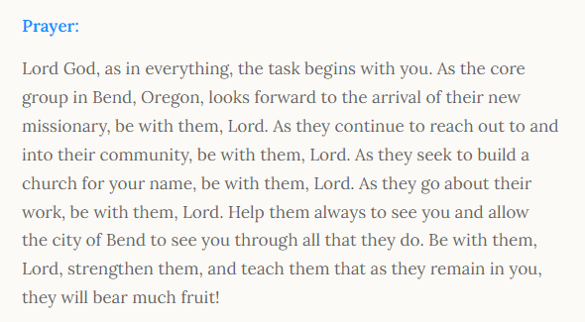
PRAY!
Notes:
Pray personally! There are WELS members out there that are personally praying for the core groups of those new missions that were approved last year. That is amazing and encouraging. Our Lord invites us to pray, so pray for workers, pray for our missionaries and their people, pray for Home Missions administration who leads the charge.
Each new start and enhancement approved in 2024 is featured on the home page at wels100in10.net. If you click on the new starts or enhancements, you’ll see a prayer provide for each one. Consider using these as part of your church services or Bible studies moving forward.

Slide 10
Notes:
Pray… at your church. Ask your pastors to pray for “100 in 10” in their worship service this summer and then this fall. You can find a prayer to use at wels100in10.net/pray.

Slide 11
Notes:
Stay connected! This is a HUGE help for this initiative. We’re still working on getting the word out to more people and be able to share with them the exciting things that are happening. Take a minute right now to follow us on Facebook or Instagram.
Like/Follow us on Facebook at fb.com/WELSmissions.
Follow us on Instagram at @WELSmissions.

Slide 12
Notes:
Subscribe to weekly Missions Blogs and quarterly Missions Update E-Newsletters at wels.net/subscribe.
Pastors, let your members know how they can stay connected with WELS mission work on social media or through our email newsletters.

Slide 13
The “Why?” Jesus said: “All authority in heaven and on earth has been given to me. Therefore go and make disciples of all nations, baptizing them in the name of the Father and of the Son and of the Holy Spirit, and teaching them to obey everything I have commanded you. And surely I am with you always, to the very end of the age.” (Mt 28:18-20).
Notes:
The One who sent us is the One who has all authority. He proved it on Easter. We celebrate it in his Ascension (see also Ephesians 1:15-23). This is the One who has commissioned us and that commission includes both nurture and outreach. It isn’t either or. This doesn’t mean there won’t be tension. There will be. There will still be congregations that are vacant that need and want a pastor. At the same time, there will still be the lost who aren’t going to be calling out for us to find them. But we still are called to that. And we see that Jesus has fully equipped us to carry out the Great Commission, giving us his Word and Sacraments and promising to go with us as we “Go…”

Slide 14
Notes:
Try something that is so hard, that if it succeeds, people will have to say God did this.
We submit all our plans to Him, for He is the Lord of the Church, and we are only servants. We’re trusting God to do immeasurably more than all we ask or imagine.

